Slide 1
Machine Learning -
Basic Principles & Practice
12. Epilogue
机器学习 – 基础原理与实践
12. 尾声
Cong Li 李聪

Slide 2
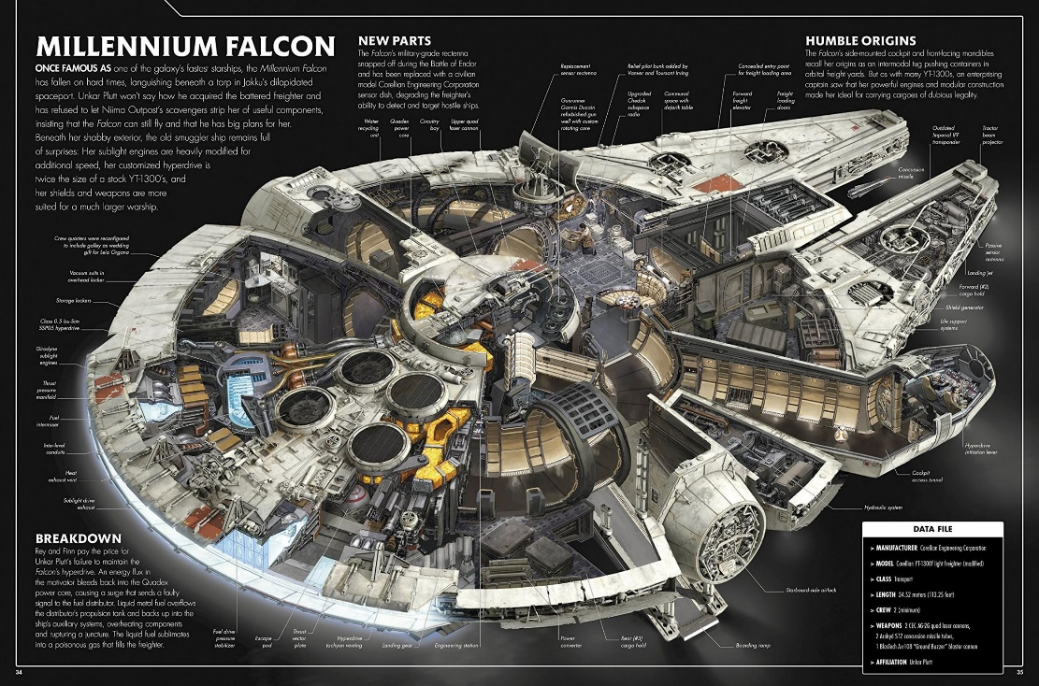
What We’ve Learned
我们学了什么
Popular science course 科普课程
A cross-section view of machine learning
机器学习的一个刨析视角

Slide 3
Inductive Learning 归纳学习
Nearest Neighbor 最近邻
Linear Classifiers 线性分类器
Learning w/ Margin 带间距的学习
Ensemble Learning 合奏学习
Complex Networks 复杂网络

Slide 4
Real World Problems 真实问题
Handwritten ZIP Code Recognition
手写邮政编码识别
Word Sense Disambiguation
词义消歧
We see performance improvement w/ multiple enhancements
随着各种改进，我们看到性能的提升

Slide 5
Principle 原理 (1)
No assumption, no learning!
无假设，不学习！
Nearest neighbor 最近邻
Close neighbors come from the same class
相似的数据来自于同一类

Slide 6
Principle 原理 (1)
No assumption, no learning!
无假设，不学习！
Perceptron or logistic regression 感知器或对数几率回归
Data are separable by a hyperplane
数据能被超平面分割

Slide 7
Principle 原理 (1)
No assumption, no learning!
无假设，不学习！
Convolutional neural network
卷积神经网络
Local & high-level patterns are indicative
局部模式和高层次模式具有指示意义

Slide 8
Principle 原理 (2)
Occam’s razor
奥卡姆剃刀
Make as fewer assumptions as possible
尽量少做假设
Simple models w/ good training performance can be powerful
在训练中表现出色的简单模型会很强大

Slide 9
Principle 原理 (2)
Occam’s razor
奥卡姆剃刀
Not sure about assumption validity: use margins or improve training confidence
对于假设的合理程度无法确信时：
使用间距或改善训练的置信度

Slide 10
But There’s Another 但还有一个
No free lunch: Everything comes at a cost!
没有免费的午餐：凡事皆有代价！
Nearest neighbor 最近邻
You need to define the distance
你必须确定距离

Slide 11
But There’s Another 但还有一个
No free lunch: Everything comes at a cost!
没有免费的午餐：凡事皆有代价！
Eager learning 积极学习
What classifier to choose? A linear one?
选什么分类器？线性分类器吗？

Slide 12
But There’s Another 但还有一个
No free lunch: Everything comes at a cost!
没有免费的午餐：凡事皆有代价！
Learning w/ margins 带间距的学习
How to determine the margin parameter?
怎么确定间距参数？

Slide 13
But There’s Another 但还有一个
No free lunch: Everything comes at a cost!
没有免费的午餐：凡事皆有代价！
Ensemble learning 合奏学习
How to construct different classifiers?
怎么构建不同的分类器？

Slide 14
But There’s Another 但还有一个
No free lunch: Everything comes at a cost!
没有免费的午餐：凡事皆有代价！
Kernel methods 核计算方法
What is the kernel? What is its parameter?
哪个核计算？参数选什么？

Slide 15
But There’s Another 但还有一个
No free lunch: Everything comes at a cost!
没有免费的午餐：凡事皆有代价！
Complex networks 复杂网络
What is the network structure? How to determine the dropout rate?
网络结构是什么？信息遗失率取多少？

Slide 16
But There’s Another 但还有一个
No free lunch: Everything comes at a cost!
没有免费的午餐：凡事皆有代价！
Making the right choice rewards you, e.g, CNN for USPS dataset: 3.29% error rate
正确的选择让你得到好的回报，例如卷积神经网络用于USPS数据集：3.29%的错误率
Nearest neighbor w/ tangent distance: 2.6%!!!
使用正切距离的最近邻：2.6%!!!

Slide 17
Popular Science Course 科普课程
Demonstrate Power of Methods
展示各种方法的威力
Not Tell How Choices Are Made
没告诉你这些选择是怎么作出的
  This is a much more complex but important topic 这是一个复杂得多但也重要得多的课题
  There is a line between scientific exploration & cheating 在科学探索和投机作弊间存在着一道界限

Slide 18
Machine Learning 机器学习
A Hot Area Today 当下的热点
If You’re Interested 如果你感兴趣
  You may learn much more
  你有很多很多可学
  You need to follow scientific methodology & engineering practice
  你需要遵循科学方法论和工程规范

Slide 19
The End

